Slide 1

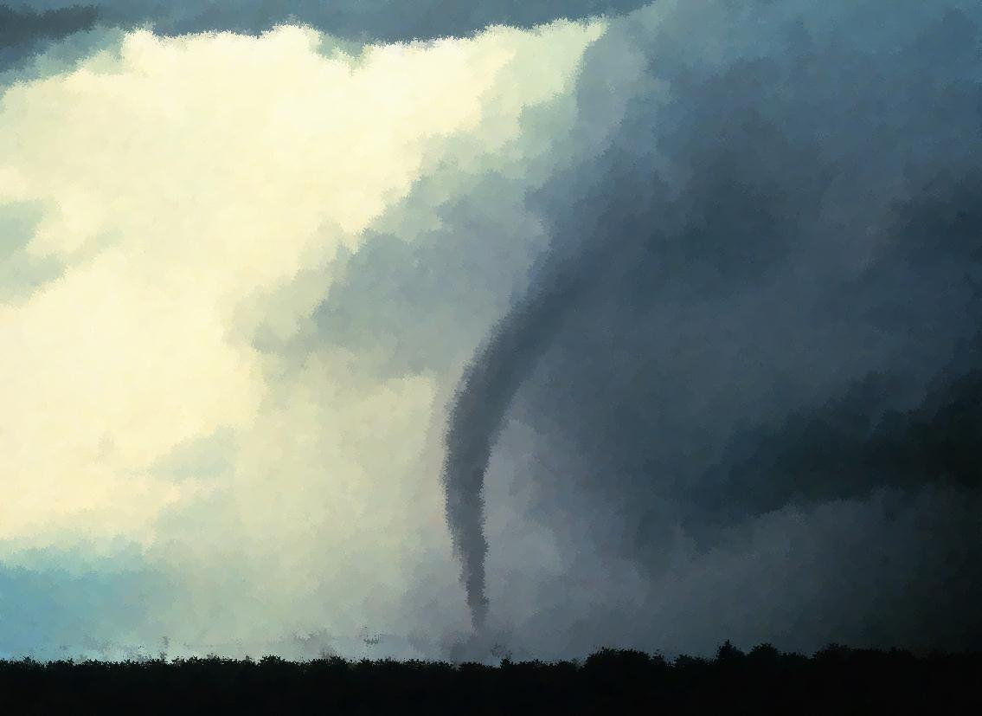
What does a tornado mean to you?
Idea of title seen in folktales
Spoken of in scripture
All verses are from the NKJV unless noted.
Notes:
Whirlwinds come in all shapes and sizes. We are very familiar with dust-devils and of course the severe twisters which come down in various storms and leave behind them much devastation and even loss of life. We had a lot of dust-devils in Washington but rarely a tornado.
Would anyone like to reap a twister? The idea is not something that we would plan for. You don’t plant and grow twisters! But the figurative idea or principle of which I am speaking is something that we are familiar with even in folktales like the three little pigs. There are some various version of it but we know it involves three pigs which make up three distinct characters. The first two are defective and build defective houses that are not appropriate for protection. They are lazier and their workmanship is poor. The big bad wolf comes, knocks, blows there house down, and depending on who is telling the story, he eats the first two pigs up. The last pig, if you will, does not sow to the wind, but is well skilled and industrious. He builds a house of bricks that can withstand the wind. Even if the wolf tries to cheat and come down the chimney, this pig is clever and has a fire waiting below. Where the first two pigs fail, the last one succeeds.

Slide 2
Hosea 8:1-7
1 "Set the trumpet to your mouth! He shall come like an eagle against the house of the LORD, Because they have transgressed My covenant And rebelled against My law.
2 Israel will cry to Me, ‘My God, we know You!’
3 Israel has rejected the good; The enemy will pursue him.
4 "They set up kings, but not by Me; They made princes, but I did not acknowledge them. From their silver and gold They made idols for themselves—That they might be cut off.
5 Your calf is rejected, O Samaria! My anger is aroused against them—How long until they attain to innocence?
6 For from Israel is even this: A workman made it, and it is not God; But the calf of Samaria shall be broken to pieces.
7 "They sow the wind, And reap the whirlwind. The stalk has no bud; It shall never produce meal. If it should produce, Aliens would swallow it up.

Slide 3

From The Prophecy
The enemy would come down upon the house of God as swift as an eagle
  Reason 1: they have transgressed My covenant
  Reason 2: they have rejected the good
    Set up kings but not by the Lord
    Set up gods of silver and gold
Assyria was the “big bad wolf”
Israel was like the three little pigs
Their kings and gods were a “house of straw”

Slide 4
Reason For Preaching a Sermon Like This:
“A prudent man foresees evil and hides himself, But the simple pass on and are punished” (Prov. 22:3)
  Foresees evil so that he may escape it
  A lot of Bible preaching foresees evil that hearers may escape it
  “Take heed to yourself and to the doctrine. Continue in them, for in doing this you will save both yourself and those who hear you”
  (1 Tim. 4:16)

Slide 5
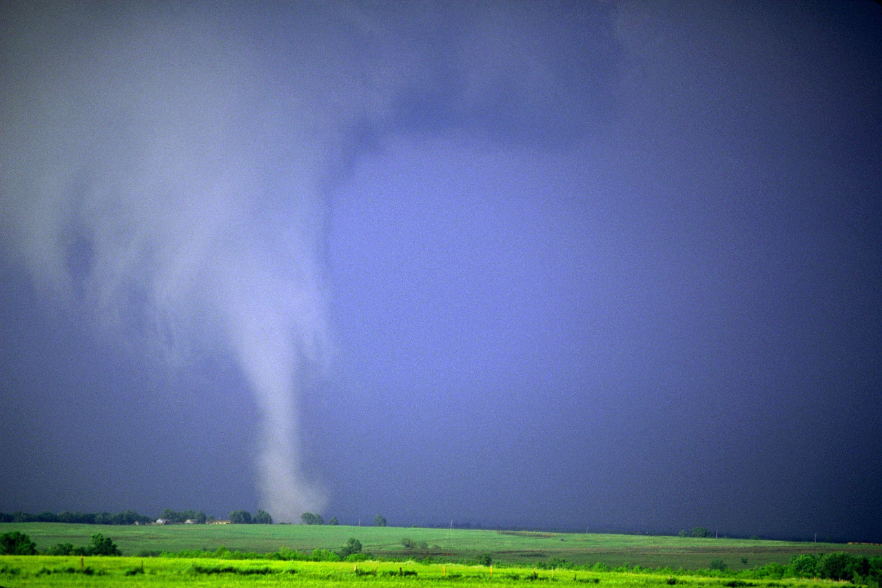
"They sow the wind, And reap the whirlwind” (Hos. 8:7)
What follows sowing to the wind?

Slide 6
“He who troubles his own house will inherit the wind, And the fool will be servant to the wise of heart” (Prov. 11:29)
SOWS trouble in his house; REAPS the wind
  What does the spendthrift bring to a man’s house (Pr. 22:7, 26, 27; 6:1-5; the mercy within the law was then not often kept Ex. 22:25-27)
  What does a slothful man bring to his house (Prov. 6:6-11)?
  What does a person greedy for great gain bring to his house (Prov. 15:27; 1 Sam. 25:2ff)?
  What does a workaholic bring to his house
  (Ps. 127:2)?
Notes:
The workaholic, like the slothful man, has an imbalance in his life. His work causes him to rise early and go to bed late. We need to recognize the balance that God established. Man was to work and toil from the fall (Gen. 3:17). Yet man was also given rest by the grace of God. This is not condemning those times when we must burn the midnight oil. It is not condemning times when we rise early to work or work late at night. The underlying issue here is the person who does not trust in the Lord and seeks to build for himself security without God. It is all in vain and so he gives up his every day to work!
The One who instituted work, also gave Israel the Sabbath and later told His apostles, “rest a while” (Mk. 6:31). Often those who are workaholics fail in faith as well and find it a burden and waste of time to give honor to God in worship for what they can do. What they have not learned is Ps. 127:1 or 2. Further, the workaholic will often neglect family time and responsibilities to remain immersed in work. He needs to recognize that children are a heritage from the Lord and enjoy them as a reward from the Lord and train them up to honor the Lord and stand against the enemies of truth (127:3-5; Pr. 22:6; etc.). A man may toil to build and care for his physical house, but God gives and builds us the enduring house through our children!
“We, sadly enough, have reversed our priorities from that given in this Psalm. Many have come to view children as a curse and work as the means of finding fulfillment and security. This is evident in the trend of the women’s movement. They are seeking to be released from the “slavery and drudgery of homemaking.” Instead, they are pursuing careers to find “fulfillment.” This is demonstrated by two observations: at worst, many women prefer abortions to relinquishing their occupations. At best, other women are willing for their children to be raised by institutions rather than to rear their own children at home” (Bob Deffinbaugh, http://bible.org/seriespage/psalm-127-word-workaholics)

Slide 7
“We, sadly enough, have reversed our priorities from that given in this Psalm [127, sjw]. Many have come to view children as a curse and work as the means of finding fulfillment and security. This is evident in the trend of the women’s movement. They are seeking to be released from the “slavery and drudgery of homemaking.” Instead, they are pursuing careers to find ‘fulfillment.’ This is demonstrated by two observations: at worst, many women prefer abortions to relinquishing their occupations. At best, other women are willing for their children to be raised by institutions rather than to rear their own children at home” (Bob Deffinbaugh, http://www.bible.org)

Slide 8
“For he who sows to his flesh will of the flesh reap corruption, but he who sows to the Spirit will of the Spirit reap everlasting life” (Gal. 6:8)
SOWS to flesh; REAPS corruption
  What does a person get when he desires to live a life after the flesh?
  “For by means of a harlot A man is reduced to a crust of bread; And an adulteress will prey upon his precious life” (Prov. 6:26)
  Proverbs 6:27-35
  Galatians 5:19-21

Slide 9
“But I say to you that for every idle word men may speak, they will give account of it in the day of judgment” (Matt. 12:36)
SOW idle words; REAP the account of it in judgment
What will a person reap who uses corrupt words (Eph. 4:29, 30)?
What of the person who uses filthy, foolish, and foul talk (Eph. 5:3-5)?
What of the person who is led by empty words (5:5, 6)?
Believing words that are filled with empty air is in fact an error!

Slide 10
Care In Heeding Empty Words
“Who make a man an offender by a word, And lay a snare for him who reproves in the gate, And turn aside the just by empty words” (Is. 29:21)
  From grumbling to using flattery (Jude 1:16; 2 Pet. 2:18)
  False wisdom (Ezek. 18:1-4)
    “one church is as good as another”
    “join the church of your choice”
    “truth is relative”
    “once saved, always saved”
    “what’s in a name, a rose called by any other name smells just as sweet”
    “salvation is by faith alone”
    “emphasize the positive, eliminate the negative”
Notes:
People often display such little control over their tongues or the simply put, they display their tongue is controlled by wickedness. They complain and grumble. It is so easy to complain and grumble. When its hot they complain it is too hot. When it is cold it is too cold. The poor complain against the rich; the sick grumble about their lot. The worldly Christian complains against preaching on worldliness and calls it negative. Many use flattery and obese words to deceive the hearts of others. They bite and devour preachers of righteousness but then publish to others how much they love God. They speak great words against some and great words for others to gain advantage.

Slide 11
“But I say to you that for every idle word men may speak, they will give account of it in the day of judgment” (Matt. 12:36)
  Care in the words we use
  Be thankful (Eph. 5:5)
    Count your blessings and gives words of thanksgiving rather than complaining
  Speak the truth rather than flattery (Eph. 4:15)
  Avoid euphemisms for “bad” words (darn, dang, OMG, Gosh, etc.)
    Not talking about euphemisms for neutral things (“fell asleep” for “died”)
Notes:
The literal meaning of the word euphemism is literally have good speech (good eu- + phēmē speech). But the idea is to give a good or less offensive word for something else. Saying that someone passed away or fell asleep simply means they died. But some euphemism have actually been created to be more offensive than the concept or reality of that which is being discussed. Taking “death” as the example, we might say “he assumed room temperature,” or “he kicked the bucket” or “he is pushing up daisies” is actually more insulting than just saying, he died. But I am not even speaking so much about that as I am, using what some deem as good words as substitutes for bad ones. Substituting another word for something vulgar or disrespectful. OMG is not necessarily foul, but it is disrespectful to God to go around saying “Oh my God.” The same seems obviously true with “Oh my Word.” “Dang,” “Darn,” “Jeez,” etc. are words to replace other words. Ask yourselves, will using expressions justify me in the day of judgment before an all holy God (Matt. 12:37).

Slide 12

What Will They Reap?
If they do not:
  Hear Jesus (Acts 3:22, 23; Matt. 7:26, 27)
  Believe in Jesus (Jn. 8:24)
  Repent of sins (Luke 13:3; Acts 17:30)
  Confess Jesus (Lk. 12:8, 9)
  Be baptized into Jesus (Mk. 16:15, 16; 2 Thess. 1:8)

